Slide 1
Advanced Image Tracking
Team :
Zhiquan Li
Fangzhou Xiong
Date: Nov/19/2017

Slide 2

Outlines :
1.
Background and Introduction
2.
ORB feature detection
3.
Optical Flow
4.
ESM algorithm
5.
Hybrid tracking algorithm
6.
Conclusions and findings

Slide 3
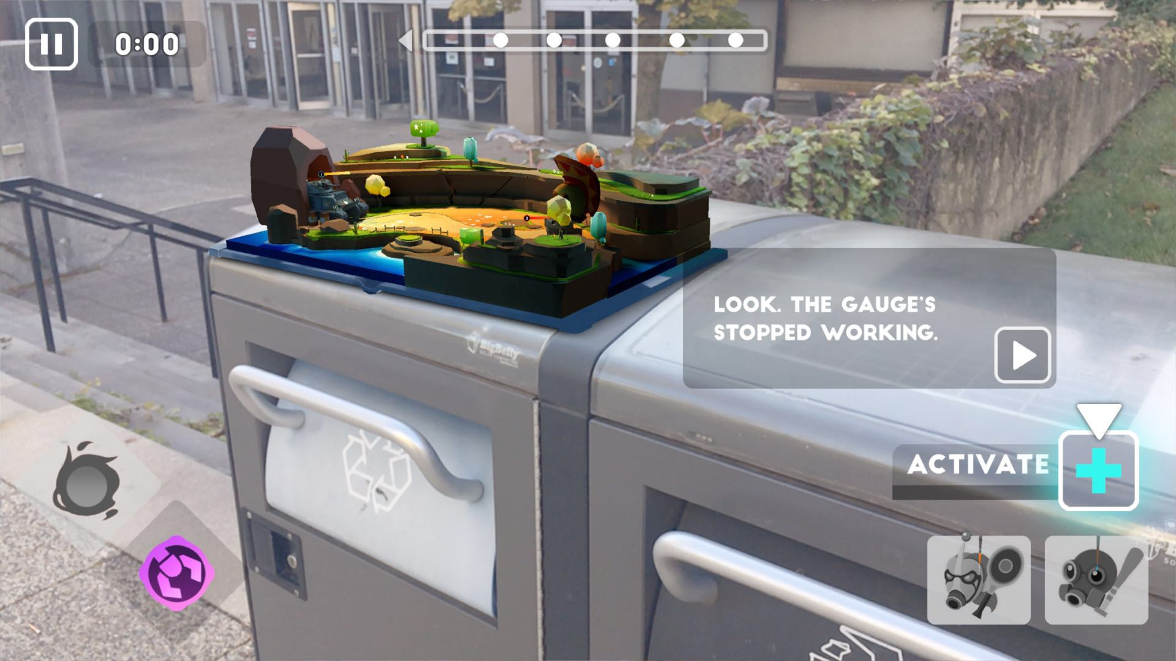
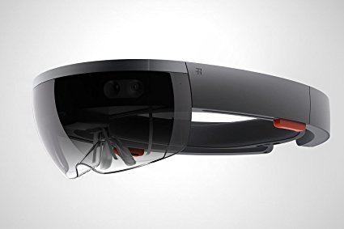
Background and Introduction
Why is Augmented Reality(AR) becoming more popular ?
To display things intuitively
Wide range of applications
AR technology is become more mature

Slide 4
Background and Introduction
Real-time performance is difficult
occlusions
geometry
illumination
How to implement AR technology more efficient?
A hybrid algorithm: Optical Flow + ESM

Slide 5
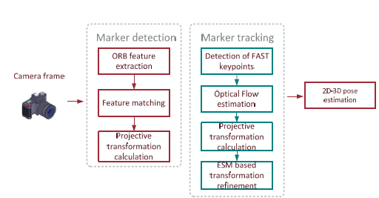
Proposed solution
Solution procedure
Advanced image tracking algorithm

Slide 6
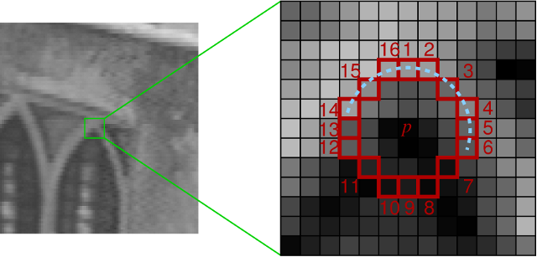
ORB feature detection
ORB: Oriented BRIEF
Rotation Invariance
FAST Keypoint
Noise sensitivity
Image Integration

Slide 7
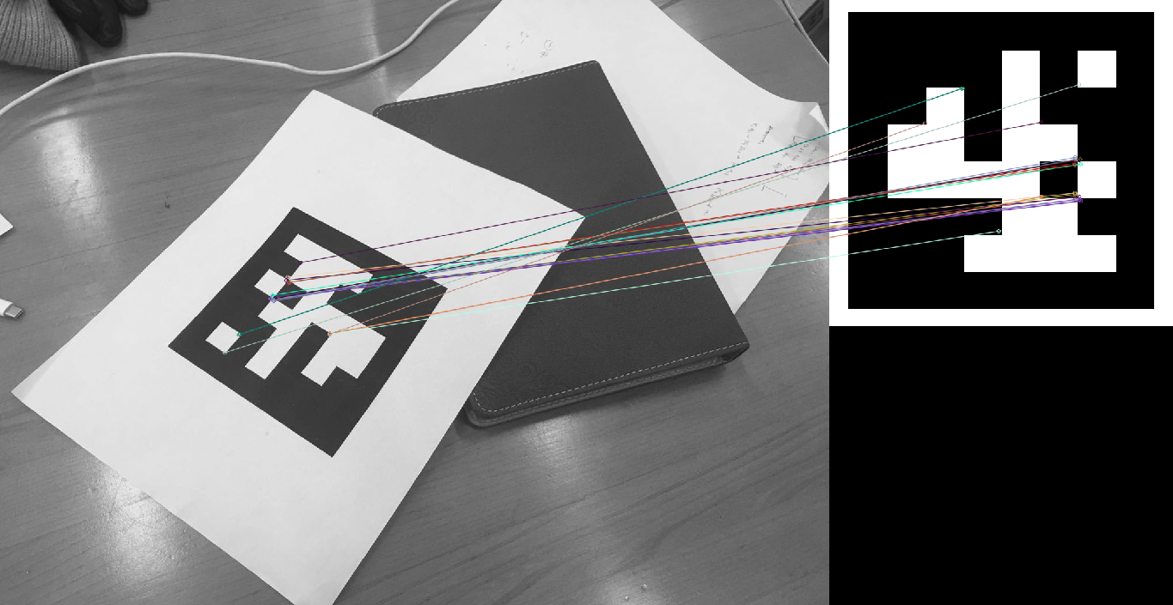
ORB feature detection
Procedure and Result:
Feature extraction
Feature matching
Only to use Matched points

Slide 8
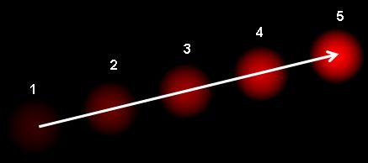
Optical Flow
Lucas-Kanade Optical Flow:
Cv2.calcOpticalFlowPyrLK()
1. Previous frame
2. Current frame
3. Feature point in previous frame

Slide 9
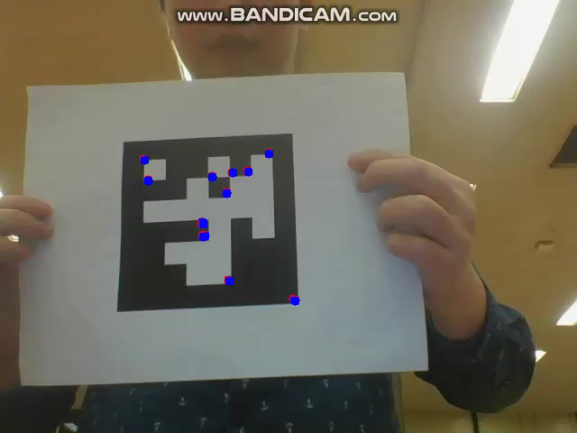
Optical Flow
Result:

Slide 10
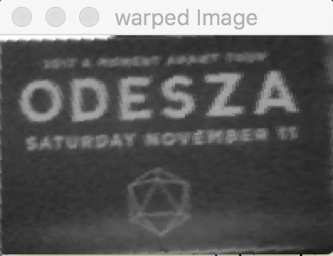

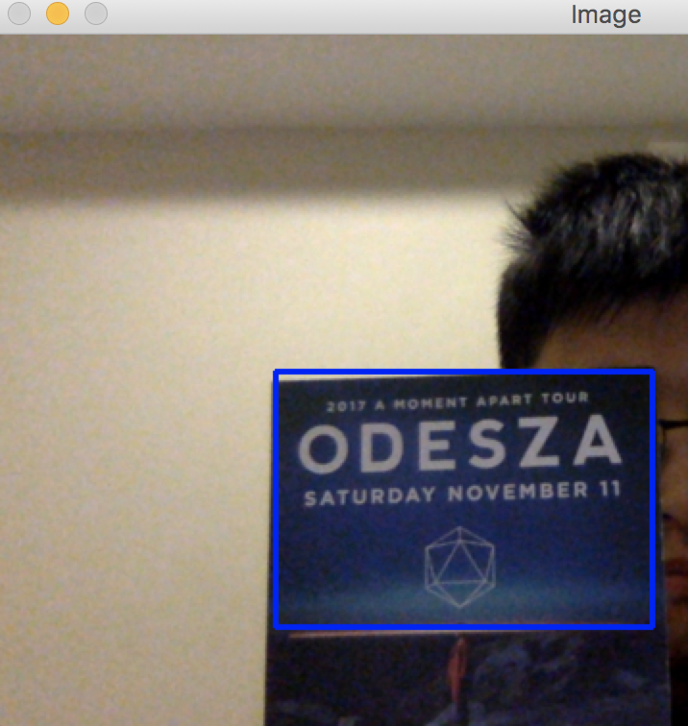
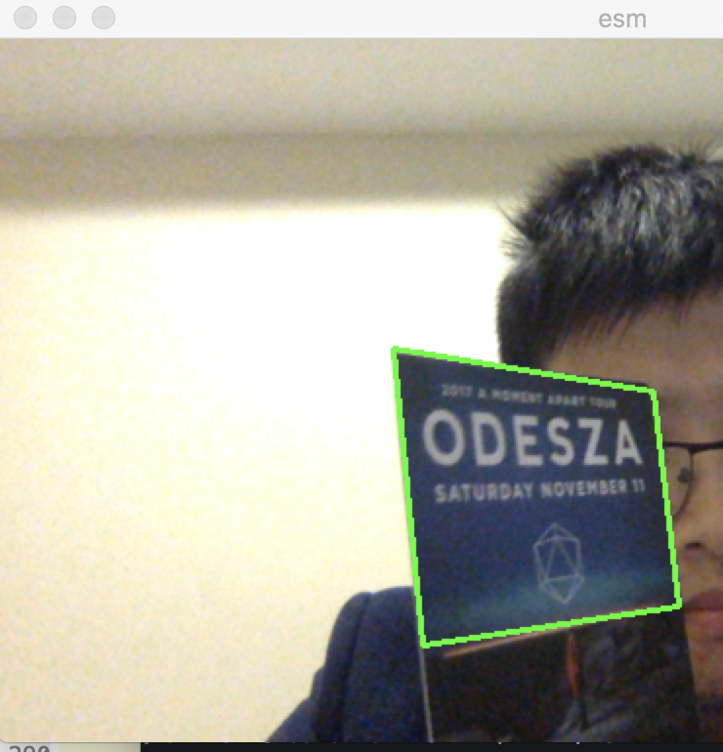
ESM Algorithm
Region-Base Tracking Algorithm
Warped Image
template
ROI Selection
ESM tracking

Slide 11
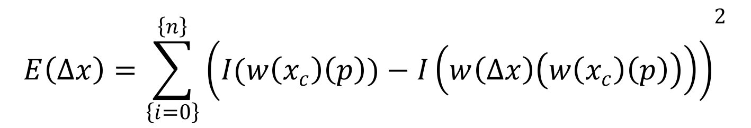
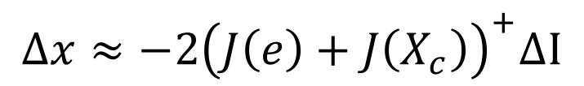
ESM Algorithm
Objective:
$${E\left(∆x\right)=\sum_{\left\{i=0\right\}}^{\left\{n\right\}}{\left(I(w\left(x_{c}\right)\left(p\right))−I\left(w\left(∆x\right)\left(w\left(x_{c}\right)\left(p\right)\right)\right)\right)}}^{2}$$
$$∆x≈−2{\left(J\left(e\right)+J\left(X_{c}\right)\right)}^{+}∆I$$

Slide 12
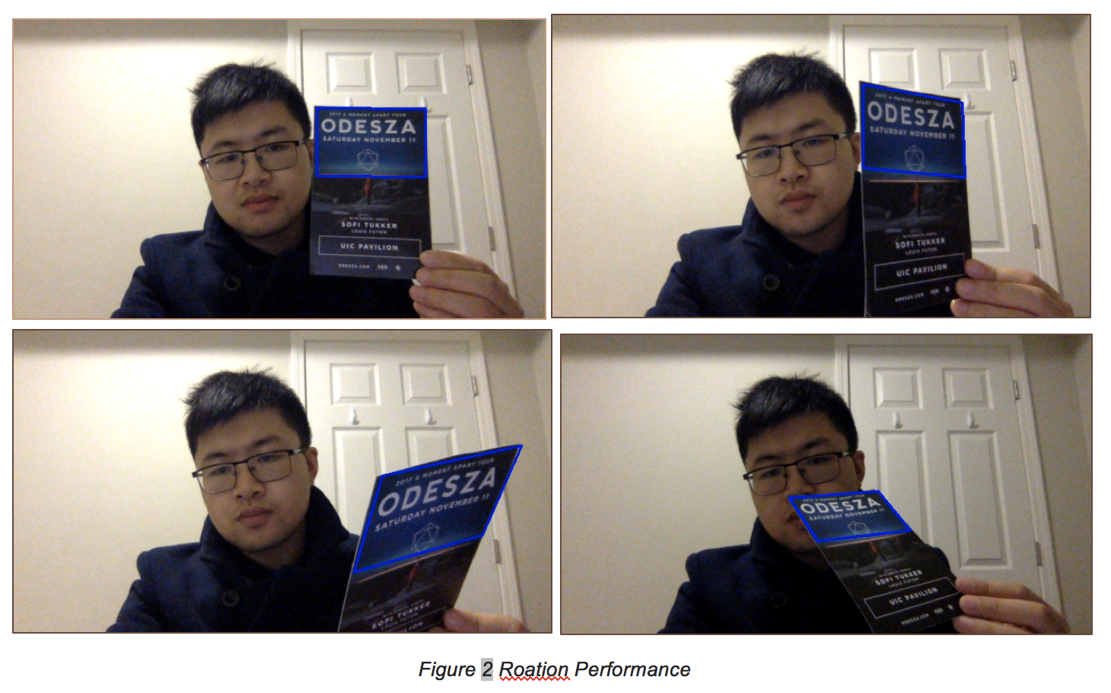
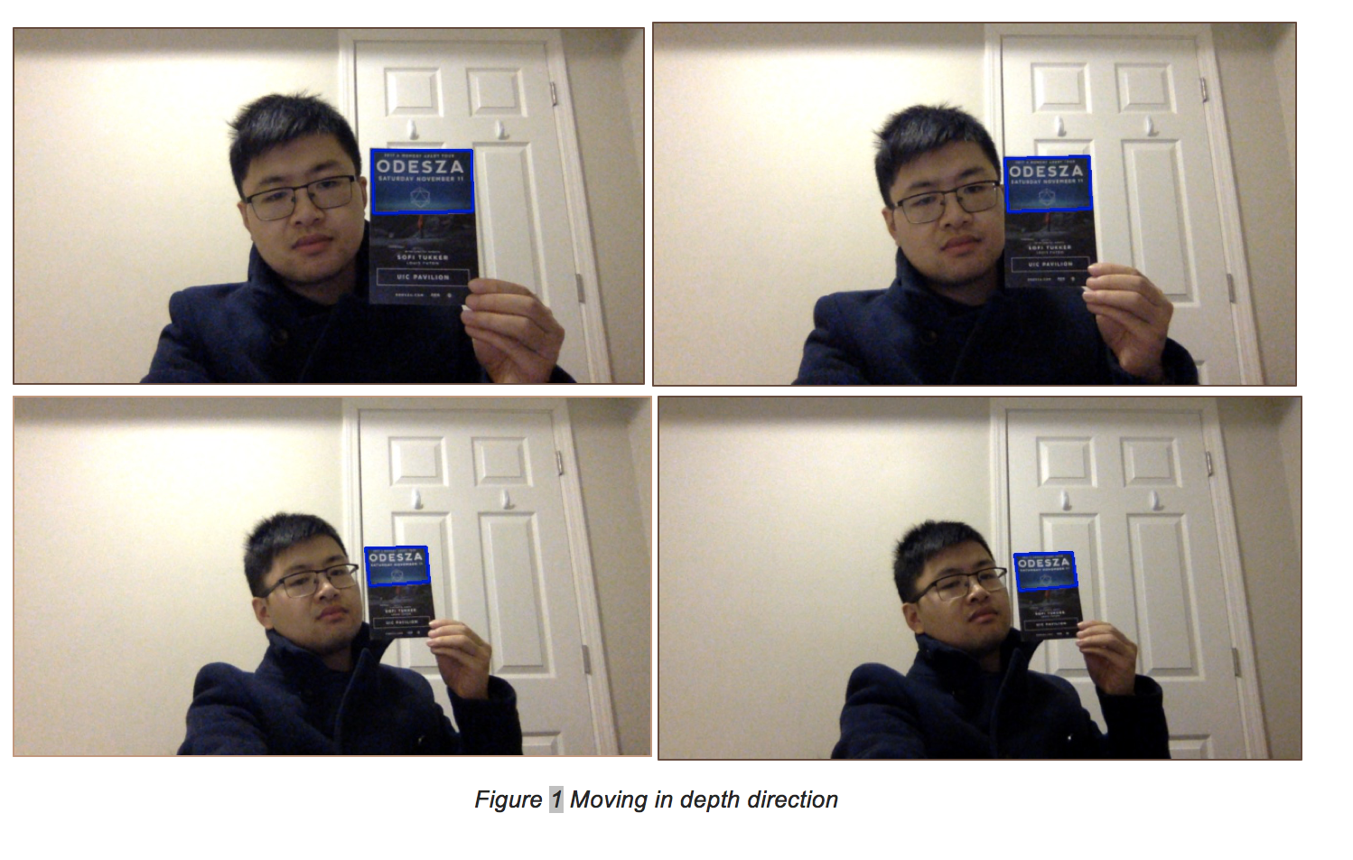
ESM Algorithm
Tracking Result:

Slide 13
ESM Algorithm
Converge:

Slide 14
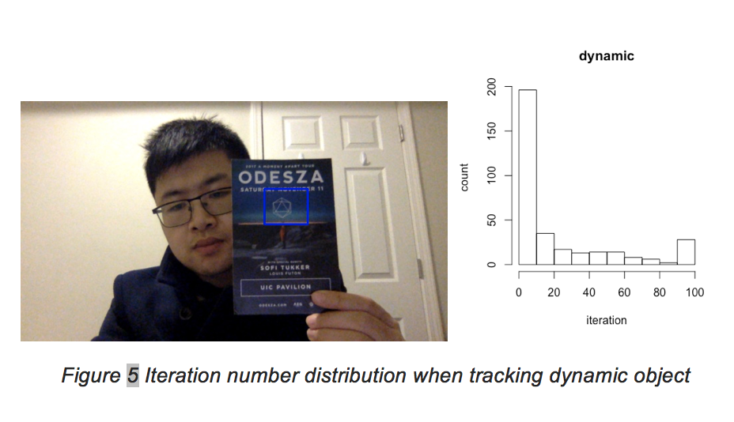
ESM Algorithm
Number of Iteration and time complexity:

Slide 15
ESM Algorithm
Number of Iteration:

Slide 16

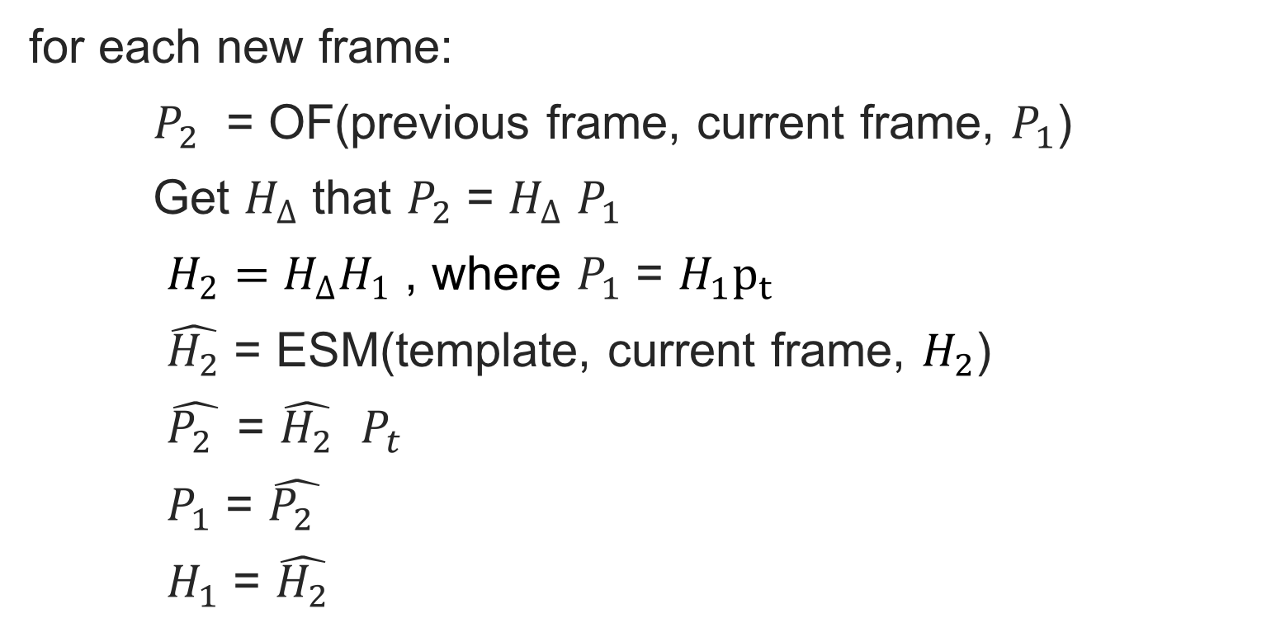
Hybrid Tracking Algorithm
Template features points $P_{t}$
for each new frame:
$P_{2}$ = OF(previous frame, current frame, $P_{1}$)
Get $H_{∆}$ that $P_{2}$ = $H_{∆}$ $P_{1}$
$H_{2}=H_{∆}H_{1}$ , where $P_{1}$ = $H_{1}p_{t}$
$\hat{H_{2}}$ = ESM(template, current frame, $H_{2}$)
$\hat{P_{2} }$ = $\hat{H_{2}}$ $P_{t}$
$P_{1}$ = $\hat{P_{2} }$
$H_{1}$ = $\hat{H_{2}}$

Slide 17
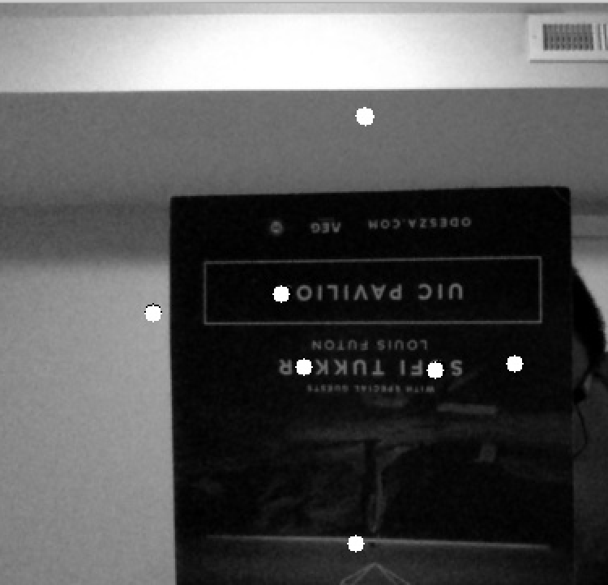
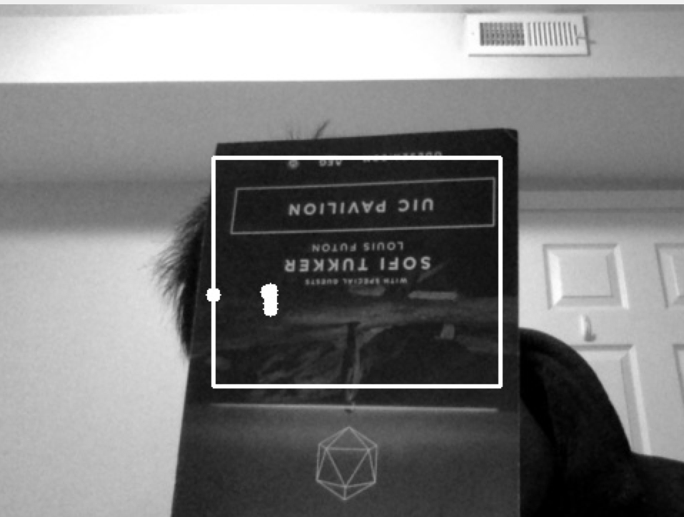
Hybrid Tracking Algorithm

Slide 18
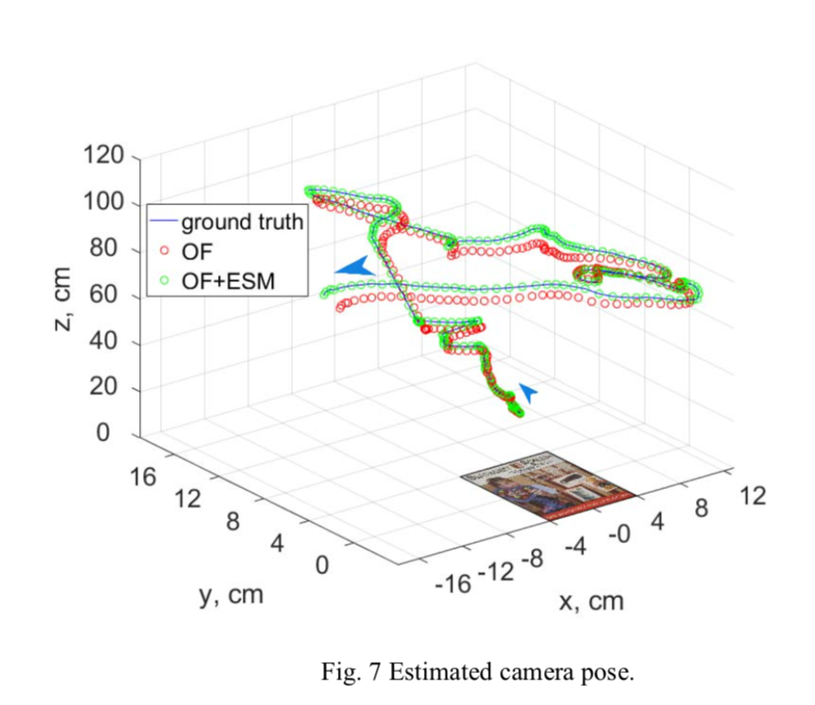
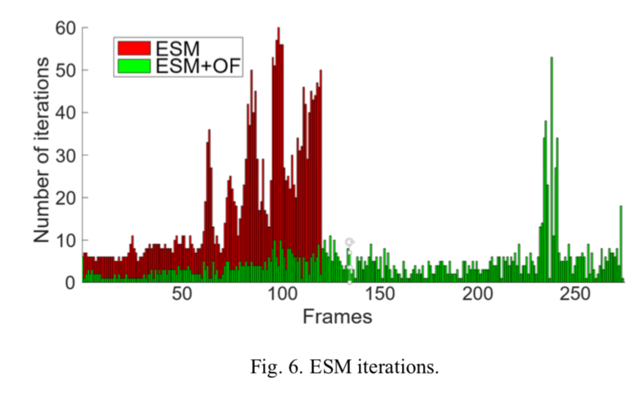
Hybrid Tracking Algorithm

Slide 19
Conclusions and Findings
1, We Implement ESM algorithm, OF tracking algorithm and the hybrid algorithm with both.
2, The ESM is time consuming but accurate.
3, Both ESM and OF are sensitive to fast movement.
4, The hybrid algorithm can help ESM converge faster.

Slide 20
References:
1. https://docs.opencv.org/trunk/d7/d8b/tutorial_py_lucas_kanade.html
2. https://docs.opencv.org/3.0-beta/doc/py_tutorials/py_feature2d/py_fast/py_fast.html
3. https://docs.opencv.org/3.0-beta/doc/py_tutorials/py_feature2d/py_orb/py_orb.html?highlight=orb
4. Ievgen M. Gorovyi and Dmytro S. Sharapov , Advanced Image Tracking Approach for Augmented Reality Applications
5. rabalho de Gradua ̧ca ̃o , Claudio Jung Orientador , 3D Tracking for an Augmented Reality System

Slide 21

THANK YOU!
Any Question

